Slide 1
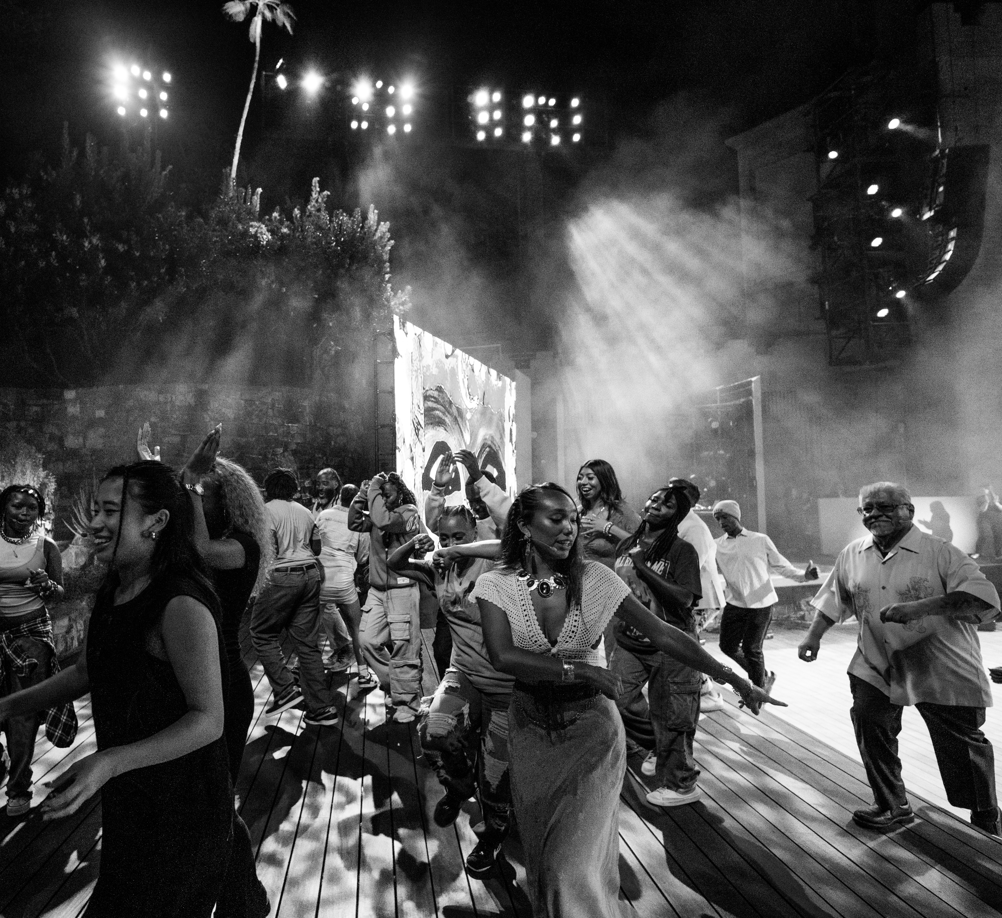

PITCH DECK · 2026
AN IMMERSIVE THEATRICAL TOUR OF THE REAL LOS ANGELES.

Slide 2
THE PREMISE
THE SHOW THAT LOS ANGELES HAS BEEN LOOKING FOR.
Fusing cutting-edge technology, immersive theatre, spoken word, music, dance, and interactive video, If I Awaken in Los Angeles is a city tour unlike anything that's come before — and unlike anything you'll see again.
FOR LA RESIDENTS
FOR VISITORS
FOR THE WORLD
A space to celebrate the city they actually live in — beyond the stereotypes, beyond the postcard. The neighborhoods, the languages, the music that make LA LA .
The Los Angeles tourists came here to find — past the Walk of Fame, past Hollywood Boulevard. The real city, told by the people who live in it.
A permanent home for the city to showcase itself — to FIFA, to the Olympics, to a billion viewers. A cultural front door for LA on the global stage.
THE PREMISE
02 OVERVIEW

Slide 3
THE PREMIERE THAT MOVED THE CITY
IF I AWAKEN IN LOS ANGELES THE PILOT PERFORMANCE.
On August 1, 2025, If I Awaken in Los Angeles made its electrifying world premiere at the iconic Ford Theatre . In partnership with The LA Philharmonic and directed by Gina Belafonte , the show had its sold-out debut.
1,000+
● PILOT PERFORMANCE · FORD THEATRE · AUG 1, 2025
SOLD-OUT ATTENDANCE
FEATURED ON STAGE
IN ATTENDANCE
PARTNERS
LUIS J. RODRIGUEZ
Former LA Poet Laureate
[PLACEHOLDER NAME]
[Title · Organization]
FORD THEATRE
Host venue
SAMANTHA RIOS
Current LA Youth Poet Laureate
[PLACEHOLDER NAME]
[Title · Organization]
LA PHILHARMONIC
Music partner
DANTE BASCO
Actor — Hook, Avatar: The Last Airbender
[PLACEHOLDER NAME]
[Title · Organization]
GET LIT
Words Ignite
MENDELEYEV
Vocalist, NBC's The Voice
PULLUM CHOIR
Fernando Pullum Community Center
WITH GET LIT – WORDS IGNITE
03 PILOT

Slide 4
REVIEW FROM OUR PILOT PRODUCTION AT THE FORD THEATRE
“
THEY DIDN'T JUST SPEAK ABOUT LOS ANGELES — THEY SPOKE AS LOS ANGELES.
— THE HOLLYWOOD TIMES
IF I AWAKEN IN LOS ANGELES
05 PRESS

Slide 5
THE LIVE ALBUM
Demand didn't stop at the stage. It surged.
IF I AWAKEN IN LOS ANGELES THE ALBUM.
Grammy-winning composer Derrick Hodge partnered with some of LA's most influential voices to extend the show's impact far beyond the theater.
30K+
FEATURING
JOY HARJO
JACKSON BROWNE
3× US Poet Laureate
8× Grammy-nominated musician
CHEECH MARIN
SEKOU ANDREWS
LISTENS · FIRST WEEK
Grammy Award–winning comedian
Grammy-nominated poet

Slide 6
REVIEWS FROM OUR PILOT PRODUCTION AT THE FORD THEATRE
“
THE AUDIENCE WILL WALK AWAY WITH AN EVEN RICHER APPRECIATION FOR THE CITY'S DIVERSITY.
— DEADLINE
“
A RICH, MOVING EXPERIENCE. THE POETRY, DANCE, AND FILM CAME TOGETHER BEAUTIFULLY.
— JODIE FOSTER & ALEX HEDISON
IF I AWAKEN IN LOS ANGELES
07 PRESS

Slide 7
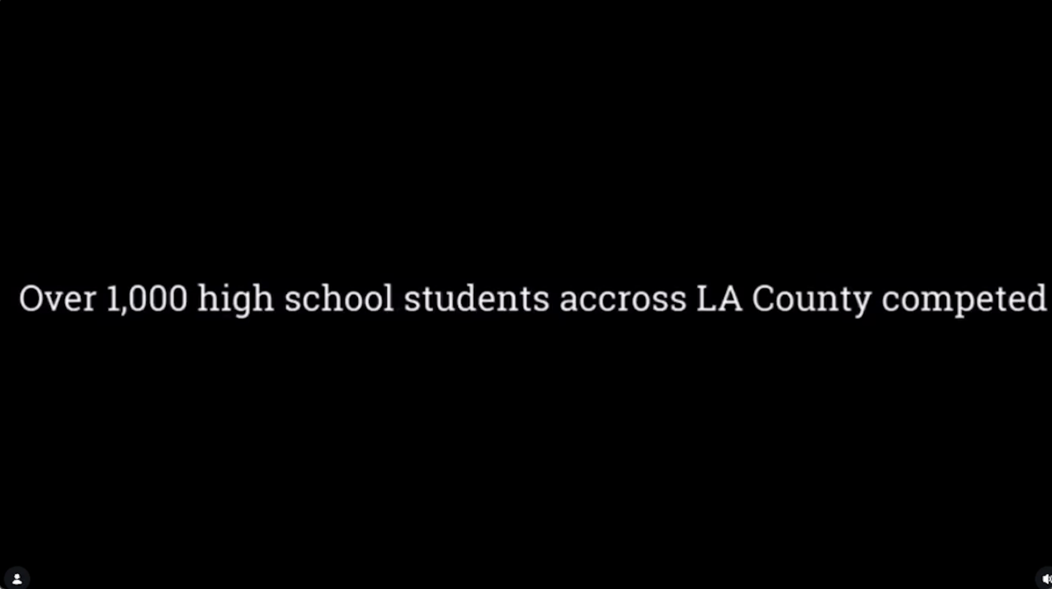
THEN THE ENTIRE CITY GOT INVOLVED
IF I AWAKEN IN LOS ANGELES THE CITYWIDE POETRY SHOWCASE
We inadvertently kick‑started the largest poetry competition in the country with a single ask: Tell us what LA means to you…
1,400+
Original submissions across LA County.
JUDGED BY
ALOE BLACC
Grammy-nominated singer-songwriter · “Wake Me Up,” “I Need a Dollar”
GINA BELAFONTE
Producer · Co-founder, Sankofa.org · Sing Your Song (HBO)
SAFIA ELHILLO
Sudanese-American poet · The January Children · Ruth Lilly Fellow
JOSÉ OLIVAREZ
Poet · Citizen Illegal · NYT bestselling Promises of Gold
CHEN CHEN
Poet · When I Grow Up I Want to Be a List of Further Possibilities
VIDEO — COMING SOON
OLIVIA GATWOOD
Poet & novelist · Life of the Party · Whoever You Are, Honey
WITH GET LIT – WORDS IGNITE
08 COMMUNITY

Slide 8
REVIEWS FROM OUR PILOT PRODUCTION AT THE FORD THEATRE
“
★★★★★
Brilliant storytelling. A groundbreaking approach to history, modernity, place, and people. This show changes everything.
ALOE BLACC
Grammy-nominated singer-songwriter — “Wake Me Up,” “I Need a Dollar”
A powerful celebration of LA's diversity and resilience. Get Lit's creativity shines. Unforgettable.
”
REINA PEREIRA
Critic · The Ford Theatre press night
IF I AWAKEN IN LOS ANGELES
09 PRESS

Slide 9
WE ARE CREATING THE SHOW THAT LA HAS BEEN WAITING FOR. THE REAL LOS ANGELES.
FOR LA RESIDENTS
FOR VISITORS
FOR THE WORLD
A space to celebrate the city they actually live in — beyond the stereotypes, beyond the postcard. The neighborhoods, the languages, the music that make LA LA .
The Los Angeles tourists came here to find — past the Walk of Fame, past Hollywood Boulevard. The real city, told by the people who live in it.
A permanent home for the city to showcase itself — to FIFA, to the Olympics, to a billion viewers. A cultural front door for LA on the global stage.
THE 2027 SHOW
10 THESIS

Slide 10
THE JOURNEY · SIX MOVEMENTS
SIX CHAPTERS, ONE CITY AWAKENING.
~110 MINUTES. LIVE ENSEMBLE THROUGHOUT. NO INTERMISSION IN THE FINAL.
STRUCTURAL MAP · THE SIX MOVEMENTS
The audience enters through the lobby, and the city speaks. Six acts. One ensemble.
539 S MISSION RD · OPENS JUNE 2027
6
TOPANGA · FINALE
1
HOLLYWOOD · THE TOUR
ACT I
BACK OF HOUSE
SEATING
2
BOYLE HTS. · TIANGUIS
ACT II
4
5
1
3
THE FIVE TOWNS
ACT III
4
SOUTH CENTRAL · BLOOD
ACT IV
SOUTH CENTRAL · THE BLOOD
THE CANYONS · FOLK
5
THE CANYONS · FOLK
ACT V
Lobby
3
2
6
TOPANGA · FINALE
BOX OFFICE · GIFT SHOP · WELCOME
FINALE
ENTRY →
THE FIVE TOWNS
BOYLE HEIGHTS
HOLLYWOOD · TOUR
PERMANENT HOME · 539 S MISSION RD
12 THE 2027 SHOW

Slide 11
VISIT · PRACTICAL MATTERS
PLAN YOUR EVENING.
DOORS OPEN ONE HOUR BEFORE EACH TOUR. LATECOMERS HELD FOR NEXT.
539 S MISSION RD · OPENS JUNE 2027
BEFORE YOU ARRIVE
A REPURPOSED INDUSTRIAL SITE , REIMAGINED AS SIX LOS ANGELESES — STACKED, ROOM-BY-ROOM.
WEAR
Shoes you can walk in.
You'll be on your feet, moving, for most of the evening.
BRING
A light layer.
The venue is warehouse-cool in the back-of-house rooms.
PHONES
On silent, lens down.
Photos welcome between acts only.
FOOD
Lobby bar & bites.
Light fare from LA partners. No re-entry to the tour once begun.
Thirty-thousand-plus square feet of warehouse, unfinished brick, polished concrete, and scaffold. Parking available on-site. Rideshare drop-off on the Mission Rd side. The lobby opens one hour before each tour — your guide is already watching you.
GROUPS
Ten or more?
Write [email protected] for block bookings.
ACCESS
ADA seating & mobility paths.
Assisted listening, sensory-mindful showings on select Wednesdays.
ADDRESS
METRO
539 S MISSION RD
A LINE · 7TH/METRO
Los Angeles, CA
Then shuttle or 15-min ride
ARRIVAL
ACCESS
30 MIN EARLY
ALL AGES · ADA
Latecomers held for next tour
13+ recommended
DOWNTOWN ARTS DISTRICT · TONGVA LAND
13 THE 2027 SHOW

Slide 12
YOUR 110 MINUTES · A RUNDOWN
THE EVENING, MINUTE-BY-MINUTE.
SEVEN STATIONS. ONE CONTINUOUS MOVEMENT FORWARD.
FIRST HALF · 0:00 — 0:50
SECOND HALF · 1:05 — 2:00
0:00
LOBBY OPENS · BOX OFFICE
1:05
ACT IV · SOUTH CENTRAL · THE BLOOD
Your guide is already watching you.
Pullum Choir, Monique, Elize & Tru. Leimert drums.
0:12
ACT I · HOLLYWOOD · THE TOUR
1:25
ACT V · THE CANYONS · FOLK
Sekou Andrews. The tour you think you know.
Lev. Banjo, guitar, the psychedelic swerve.
0:24
ACT II · BOYLE HEIGHTS · TIANGUIS
1:43
FINALE · TOPANGA · THE LAND REMEMBERS US
Luis J. Rodriguez & Jasmine Minchez. Mariachi Square.
Sammy invokes the Chumash. The whole house sings.
0:40
ACT III · THE FIVE TOWNS
1:50
BOW · THEME REPEATS
Dante Basco, Jason & Ariana. Five verses, one hook.
Band plays out. House lights slow. Lobby re-opens.
0:50
INTERMISSION · 15 MINUTES
2:00
AFTER · GIFT SHOP & ALBUM
Band plays theme out. Lobby & bar.
Cast recordings available in the lobby. Signings on select nights.
~110 MINUTES · ONE CONTINUOUS MOVEMENT FORWARD
14 THE 2027 SHOW

Slide 13
MEET THE TEAM
THE PRODUCERS.
DIANE LUBY LANE
BRANDON XIV
CREATOR & LEAD PRODUCER · FOUNDER, GET LIT
LEAD PRODUCER · CREATIVE TECHNOLOGIST
PHOTO DIANE LUBY LANE
Founder & CEO of Get Lit – Words Ignite; author of the original Get Lit curriculum, now in 200+ schools worldwide. Featured in the LA Times, CNN, and NPR. Recipient of the James Patterson Page Turner Award and the Presidential Lifetime Volunteer Service Award.
PHOTO BRANDON XIV
Co-founder of SHOWRUNNER, a film tech company specializing in the development of emerging technology to create groundbreaking productions. Brandon's unique blend of creative vision and technical ingenuity has earned countless awards across each of the film, tech, and film-tech industries.
SHANE SNOW
GINA BELAFONTE
ROB O’NEILL
PRODUCER · JOURNALIST & AUTHOR
PRODUCER · ARTIVIST
PRODUCER · PARAMOUNT GLOBAL
Tony Award–winning producer, TV and film writer–producer, and bestselling author. Award-winning journalist (GQ, Wired, The New Yorker) and a Pulitzer Prize entrant for investigative journalism.
Award-winning producer, director, and activist; Co-Founder & Executive Director of Sankofa.org. Lead producer of the HBO documentary Sing Your Song (Sundance 2011 opener) about her father Harry Belafonte. Director of the hip-hop/spoken-word musical Lyrics from Lockdown . Co-founder of The Gathering for Justice.
SVP, Content Strategy & Acquisitions at MTV Entertainment & Showtime Studios (Paramount Global), overseeing Yellowstone , The Daily Show , and South Park . Tony Award winner as co-producer of Broadway’s The Outsiders (2024). Co-producer of The Who’s Tommy (US) and Burlesque, The Musical (UK).
LEADERSHIP
15 TEAM

Slide 14
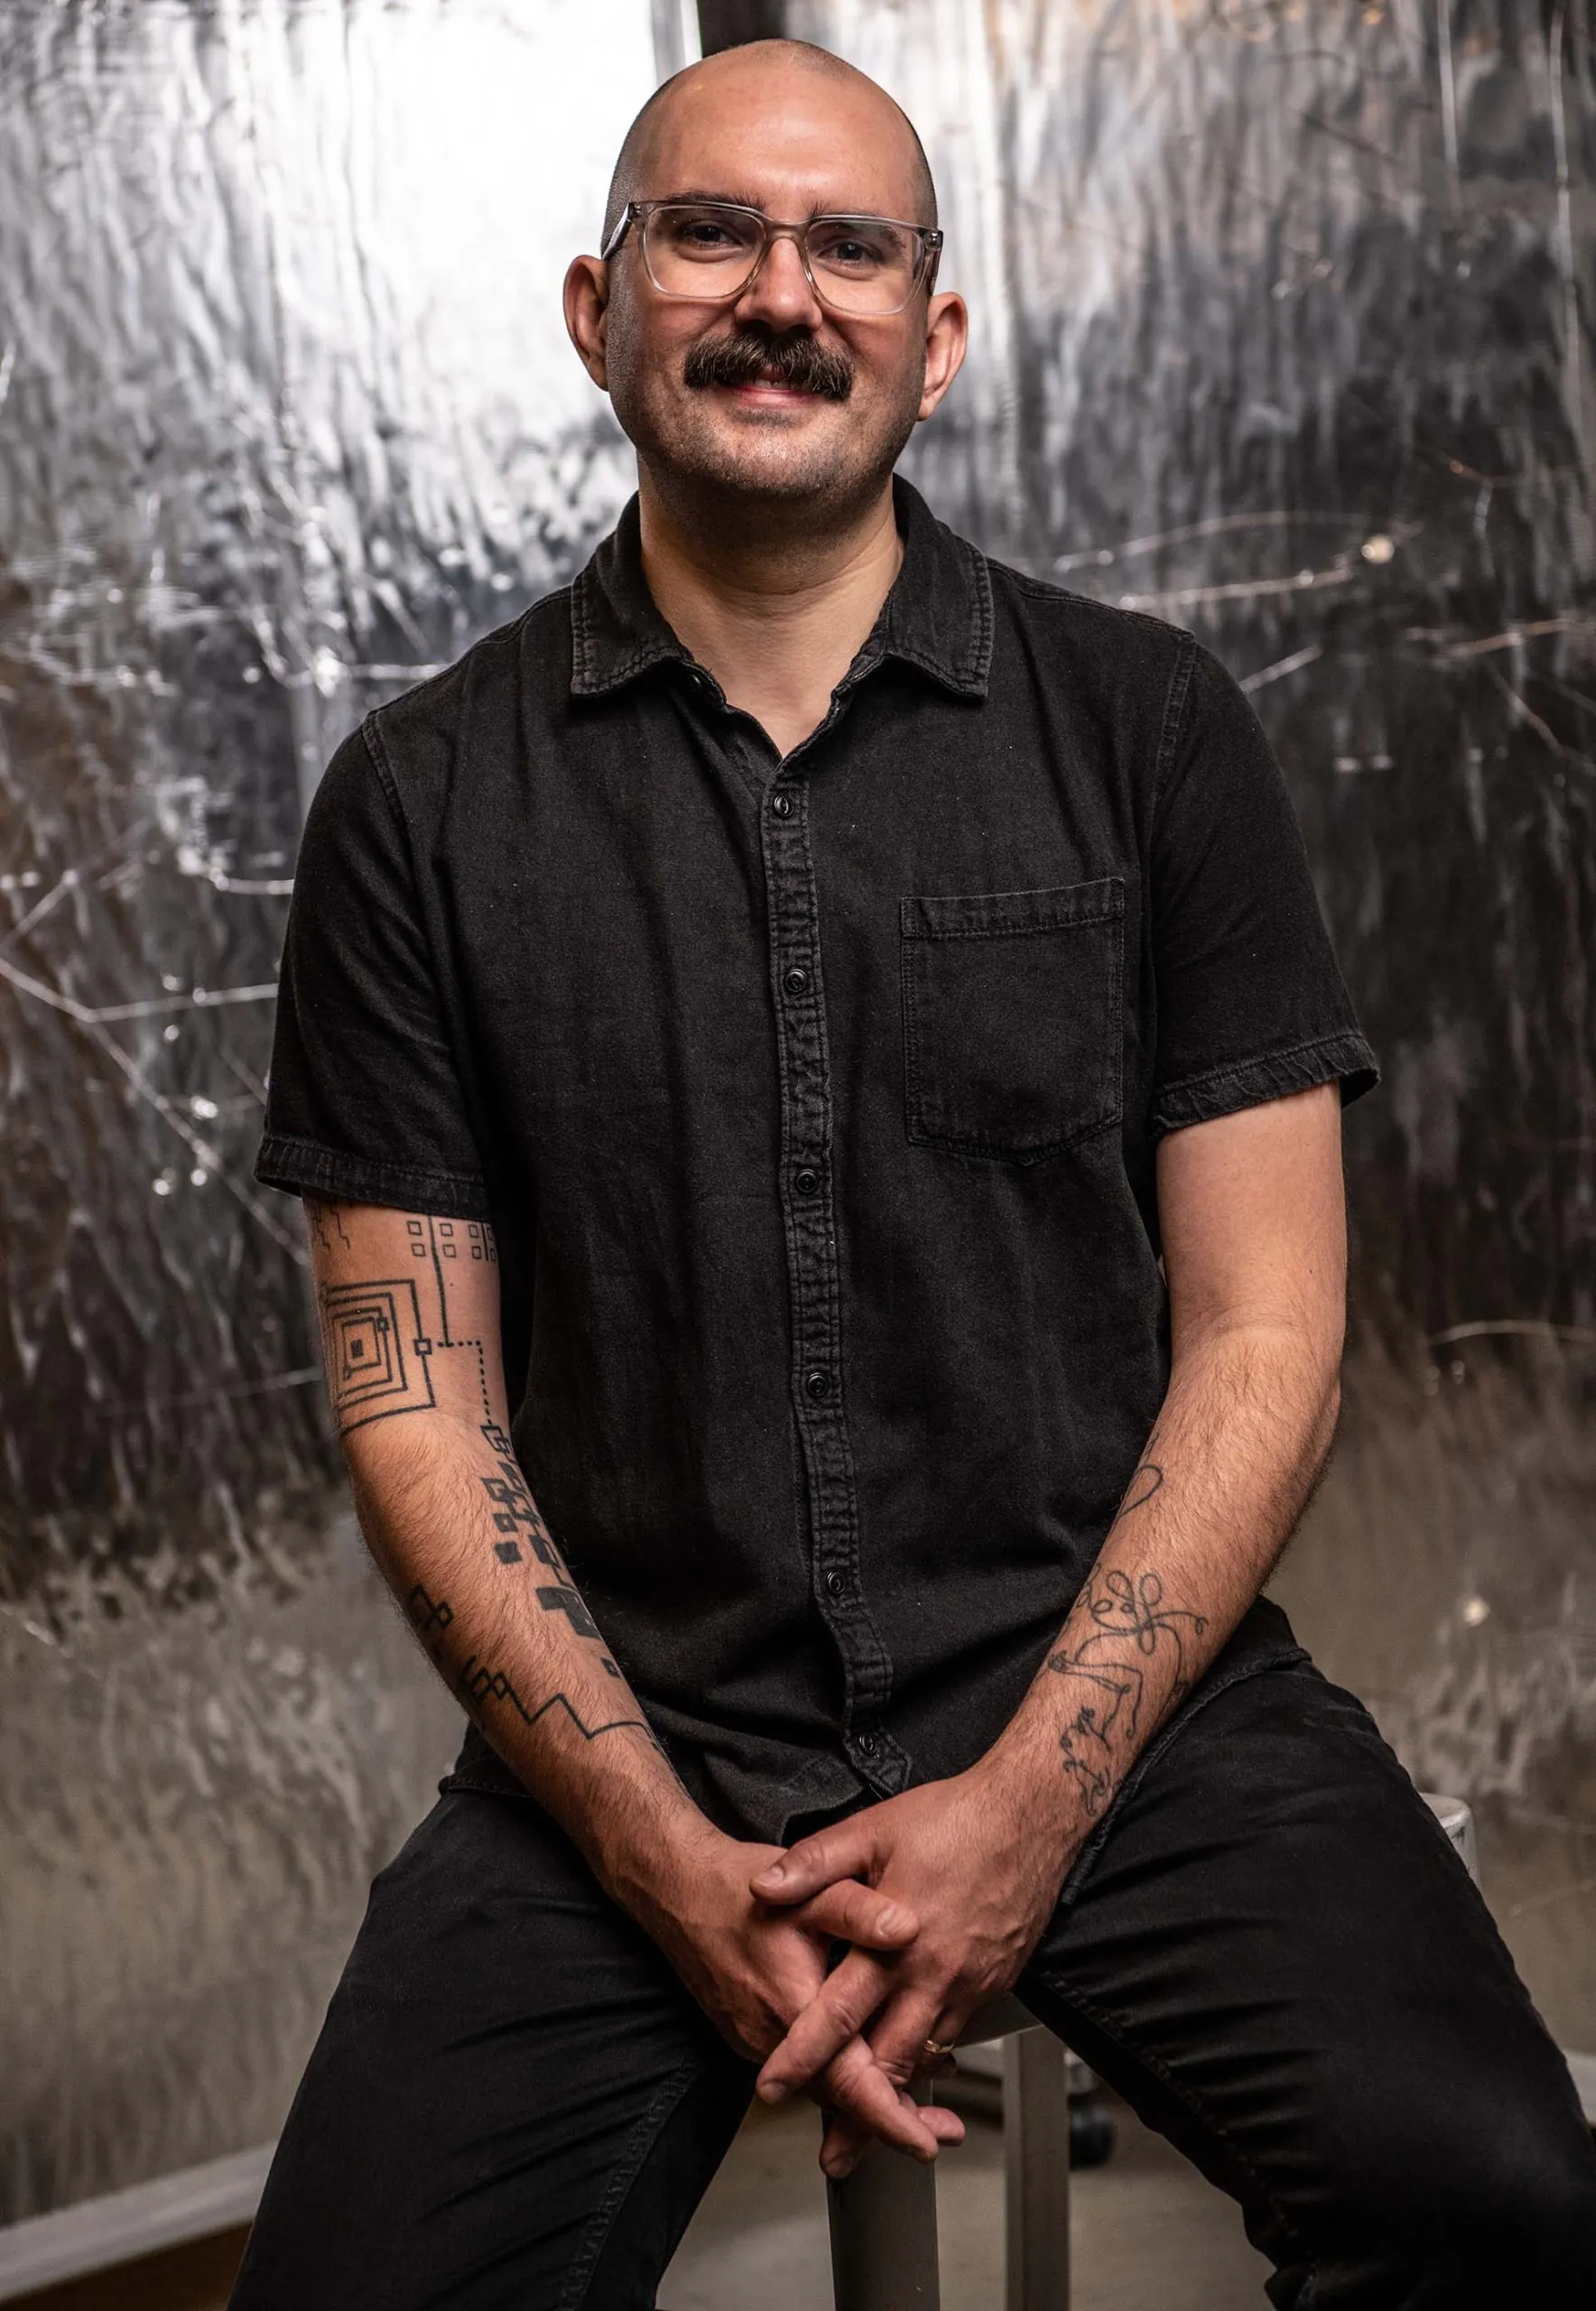
PHOTO MARK CHINAPEN
THE DIRECTOR
THE GENERAL MANAGER
ANDREW SCOVILLE.
MARK CHINAPEN.
Immersive work, built room by room.
Large-scale live production, built room by room.
BROADWAY · ASSOCIATE DIRECTOR
HERE LIES LOVE
PRESIDENT & OWNER
BIG TIME AFFAIRS
David Byrne · The Broadway Theatre
LA-based live-event production company
IMMERSIVE DIRECTOR
THEATER OF THE MIND
FESTIVALS
COACHELLA · STAGECOACH
David Byrne & Mala Gaonkar · DCPA
Multi-stage activations & artist hospitality
LOCATION-BASED DIRECTOR
MONEY HEIST: THE EXPERIENCE
AWARDS & BROADCAST
THE GRAMMYS · WORLD OF DANCE
Netflix · Immersive theatrical
Custom staging, audio, lighting, fabrication
PRACTICE
MULTI-ROOM · AUDIENCE-ON-FOOT
PRACTICE
FULL-SCALE OPERATIONS · NORTH AMERICA
Hybrid-genre production for permanent-home venues
Private dinners to Super Bowl activations
DIRECTOR & GENERAL MANAGER · HIRED FOR THE PERMANENT HOME
16 TEAM

Slide 15
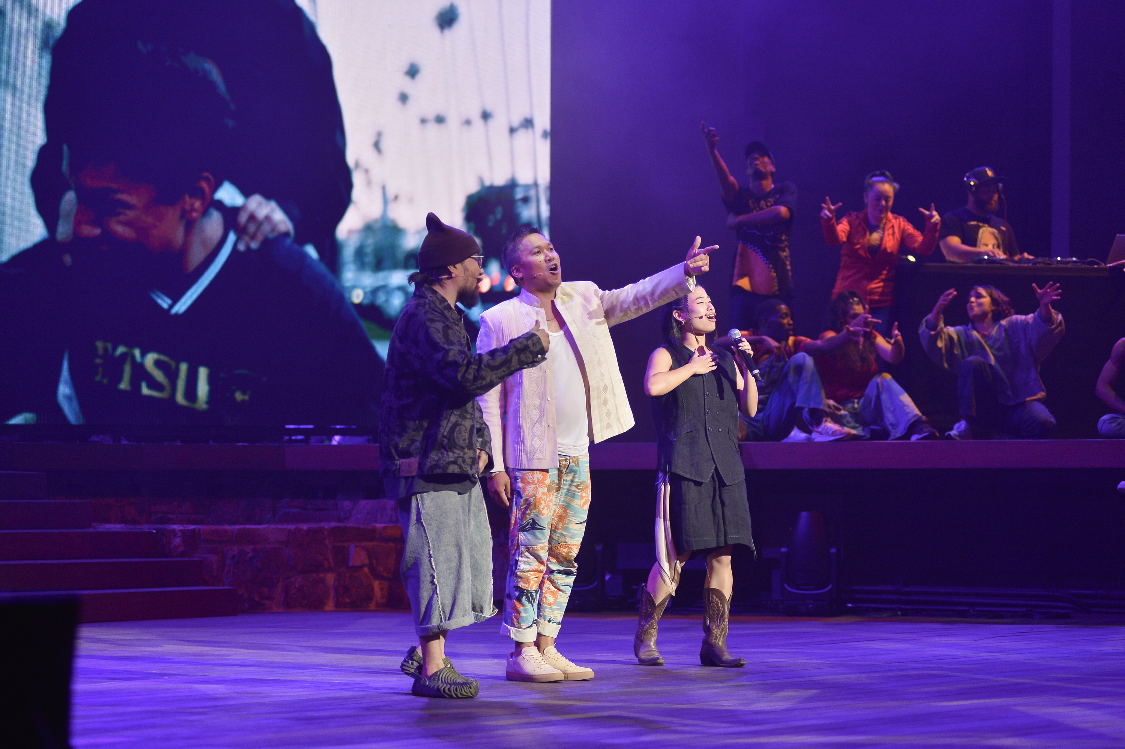
ROTATING CAST
OPPORTUNITIES FOR SPECIAL GUESTS.
Each chapter of the show is brought to life by artists and leaders who carry true cultural capital within their communities — from legacy figures like Cheech Marin to contemporary visionaries like Issa Rae. A rotating cast of cultural icons whose stories and influence are woven into the fabric of Los Angeles.
CHEECH MARIN
ISSA RAE
JOY HARJO
JACKSON BROWNE
DANTE BASCO
LUIS J. RODRIGUEZ
ALOE BLACC
SEKOU ANDREWS
MENDELEYEV
SAMANTHA RIOS
CULTURAL CAPITAL · REAL VOICES
17 TEAM

Slide 16
A GLOBAL STAGE
A CITY TRANSFORMED.
Over the next few years, Los Angeles will become the center of the world. Millions of visitors pour in. Billions watch from around the globe. LA becomes the place where the world comes to witness what the future looks and feels like. If I Awaken in Los Angeles is built for this stage — a show that can anchor festival programming, activate cultural pavilions, integrate into international arts showcases, and serve as a marquee event for visitors hungry to experience the city beyond the stadiums.
'26
FIFA WORLD CUP
SOFI STADIUM
'27
SUPER BOWL LXI
SOFI STADIUM
'28
SUMMER OLYMPICS
LA28 · CITY-WIDE
'28
PARALYMPIC GAMES
LA28 · CITY-WIDE
POSITIONED FOR THE MOMENT
18 OPPORTUNITY

Slide 17
IF I AWAKEN... THE FRANCHISE
IF I AWAKEN IN EVERY CITY.
IF I AWAKEN IN CHICAGO
IF I AWAKEN IN NEW YORK
IF I AWAKEN IN NEW ORLEANS
Where house music comes alive — the electric complexity of the South Side to the lakefront.
Subway rhythms, diaspora stories — five boroughs, one breath.
Every brass note and street corner a chapter of America's spiritual lineage.
TOURING CIRCUITS
FESTIVAL PARTNERSHIPS
STREAMING ADAPTATIONS
MUSEUM INSTALLATIONS
EDUCATIONAL PROGRAMS
MERCHANDISE & PUBLISHING
PLACE-ROOTED STORYTELLING · COMMERCIALLY SCALABLE
19 OPPORTUNITY

Slide 18
In Los Angeles, things take root.
People from all over the world feel this, and so they flock here — the dreamers, the wanderers, the immigrants, in search of a chance, a rebirth, a fresh start. And the city receives them.
A NOTE FROM OUR PRODUCER
— DIANE LUBY LANE
LOS ANGELES HAS LOVED US. WITH THIS SHOW, WE OFFER THAT LOVE BACK.
FROM THE PRODUCER
20 OPPORTUNITY

Slide 19
SUMMARY · IMPACT
LOS ANGELES DESERVES A SHOW THAT REPRESENTS THE CITY — ITS PEOPLE, ITS CULTURES, ITS TRUTH.
The city is starving for great experiences.
A CULTURAL ANCHOR
AN ECONOMIC ENGINE
A GLOBAL CALLING CARD
A permanent home for the stories LA tells about itself — built in the Arts District, owned by the city, not exported back to it. The first show of its kind to put the real Los Angeles at the center, every night.
12 shows a week, 60 weeks a year, drawing audiences from across the basin and beyond. Jobs for actors, musicians, dancers, technicians — and a reason for visitors to stay an extra night.
Opening months before the World Cup, a year before the Olympics. As billions of eyes turn to LA, this is the show the city points to — its front door on the world stage.
THE OPPORTUNITY
21 SUMMARY

Slide 20
INVESTOR APPENDIX · 01
THE ASK.
A 60-week Los Angeles run. 12 shows a week. A transformed 30,100 sq ft warehouse at 539 S Mission Rd.
$ 5.97 M
INVESTOR TIER
$3.28M · 55% of cap stack
Recoupable at 120%, plus 50% profit share post-recoup.
BALANCE
$2.68M · grants + philanthropy + community
TOTAL CAPITALIZATION · FULLY-LOADED
Non-recoupable capital. De-risks the investor tier by 45%.
WEEKLY GROSS POTENTIAL
$163,000
1,800 seats × weighted avg $90.56 · 150-cap × 12 shows.
BREAKEVEN
64.1% capacity
Pilot at The Ford oversold at 1,000+ — strong demand signal.
NO ROYALTY MODEL · COMPOSITION RIGHTS OWNED BY PRODUCTION
22 INVESTOR

Slide 21
INVESTOR APPENDIX · 02
USE OF FUNDS.
Every line from the production budget — rolled up into nine categories. The build is real; the numbers are conservative.
SCENIC & PHYSICAL PRODUCTION
$2,314,250
38.8%
CREATIVE & MGMT FEES
$1,008,879
16.9%
LAUNCH MARKETING
$754,500
12.6%
RESERVE & CONTINGENCY
$714,325
12.0%
PRE-OPENING SALARIES
$394,919
6.6%
BONDS, DEPOSITS, ADVANCES
$233,500
3.9%
LOAD-IN LABOR & VENUE
$190,794
3.2%
CASTING, MUSIC, DEV
$179,900
3.0%
G&A · LEGAL · INSURANCE
$174,700
2.9%
TOTAL CAPITALIZATION
$5,965,767
100%
SOURCE: PRODUCTION BUDGET V4 · APRIL 2026 · LED WALL OWNED (8-MO BREAKEVEN) · COMPRESSED 2+2+2 PRE-OPEN
23 INVESTOR

Slide 22
INVESTOR APPENDIX · 03
THE ECONOMICS.
Every performance has a community-access tier. Accessibility is built into the pricing — not isolated to one night a week.
TIERED PRICING · WEEKLY GROSS BUILD
WEEKLY GROSS POTENTIAL
WEEKLY OPERATING
TIER
SEATS/WK
AVG $
WEEKLY $
$163K
$106K
Community
520
$50
$26,400
At 100% capacity · 1,800 seats.
All-in: salaries, rent, marketing, maintenance.
Standard
720
$83
$58,800
Premium
480
$132
$63,000
WEEKLY CONTRIBUTION @ 100%
BREAKEVEN CAPACITY
VIP · Saturday only
80
$185
$14,800
$56.7K
64.1 %
Weekly Gross
1,800
$90.56
$163,000
Plus 15–25% upside from bar, shop, concessions.
96 of 150 avg seats filled per show.
WEIGHTED AVG TICKET
COMMUNITY SEATS / WEEK
$90.56
520
Across Community, Standard, Premium, VIP.
29% of weekly capacity at access pricing.
TIERED WITHIN EVERY PERFORMANCE · THU COMMUNITY NIGHT RESERVES 80 SEATS AT $40
24 INVESTOR

Slide 23
INVESTOR APPENDIX · 04
CAP STACK.
A four-source structure. Non-recoupable capital carries 45% of the raise — so investors absorb less of the downside and keep all of the upside.
INVESTOR TIER · TERMS
INVESTOR CAPITAL
55%
Recoupable · profit share
$3.28M
120% of principal before profit share
Investor tier recoups at 1.2× before any profit distribution begins.
INSTITUTIONAL GRANTS
25%
50 / 50 profit split after recoupment
NEA · Mellon · LADF · mission-aligned
$1.49M
Profits split evenly between investor pool and production post-recoup, for the life of the run and any downstream licensing.
INDIVIDUAL PHILANTHROPY
15%
Non-recoupable capital de-risks 45% of the raise
Named sponsorships & major gifts
$0.89M
Grants and philanthropy carry nearly half the capitalization with no claim on returns — every dollar of upside flows to the investor tier and production.
COMMUNITY & EARNED
5%
Memberships · crowdfunding · pre-sales
$0.30M
No royalty obligation
Derrick Hodge's score composition rights are owned by the production. Director & writer compensated on weekly salary in lieu of a royalty pool — lower overhead, cleaner downside.
MISSION-ALIGNED CAPITAL STACK · INVESTOR PROTECTION BUILT IN
25 INVESTOR

Slide 24
INVESTOR APPENDIX · 05
RECOUP PATHS.
Weeks-to-recoup across capacity scenarios, against a 60-week run. Pilot demand suggests the upper band is achievable.
AVG CAPACITY
WEEKLY GROSS
WEEKLY CONTRIB.
INVESTOR TIER RECOUP
WITHIN 60-WK RUN
110%
$179,300
$72,546
45 wks
✓ YES · + BAR/SHOP UPSIDE
100%
$163,000
$56,734
58 wks
✓ YES
90%
$146,700
$40,924
80 wks
WITHIN RUN + TOUR
85%
$138,550
$33,018
99 wks
RUN + TOUR LICENSING
80%
$130,400
$25,113
131 wks
REQUIRES EXTENSION / TOUR
64.1%
$104,511
Breakeven
—
OPERATING BREAKEVEN ONLY
BASE CASE
UPSIDE NOT MODELED
90% avg capacity ≈ 135 of 150 seats per show. Recoups the investor tier in 80 weeks — inside the 60-week LA run plus the first tour leg. Pilot at The Ford oversold a 1,000-seat house.
Bar, gift shop, merch, group add-ons, corporate buyouts, and the "If I Awaken in…" franchise playbook (Chicago, New York, New Orleans) are conservatively excluded from these scenarios.
SCENARIOS EXCLUDE 15–25% ANCILLARY REVENUE UPSIDE
26 INVESTOR

Slide 25
RESERVE YOUR NIGHT · OPENS JUNE 2027
THE LAND REMEMBERS US.
NEW HOME
539 S MISSION RD
DIRECTOR
ANDREW SCOVILLE
Opens June 2027
Here Lies Love · Theater of the Mind
PRODUCER
GET LIT — WORDS IGNITE
COMPOSER
DERRICK HODGE
Join us at 539 S Mission Road — for the most honest tour of Los Angeles you will ever take.
Grammy-winning · live album out now
Diane Luby Lane, founder
RUN
~110 MIN
ELSEWHERE
IFIAWAKEN.LA
RESERVE →
MAILING LIST
PRESS KIT
No intermission in the final movement
@ifiawaken · [email protected]
© 2026 · THE AWAKEN COMPANY · MADE ON TONGVA LAND
27 RESERVE

